Slide 1
Thomas Serafin Jakub Trawinski Gustavo Silva Corey Delgado
UAV

Slide 2
History
The first use of a unmanned aircraft was in the mid 1800’s in the way of Balloons that were partially successful
During WWI in the 1910 to 1920’s on Sept.12 the more common UAV was built giving the name “flying bomb”
In WWII in 1941 the first televised camera was installed on drone. Due to the software a destroyer was hit from 20 miles away.
Public image of UAV’s changed in the Israeli Air Force victory over the Syrian Air Force in 1982.
New advances keep developing due to terrorism and nation security for the public’s defense.

Slide 3
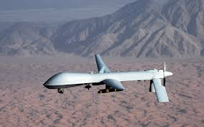
MQ-1 Predator
MQ-1 Predator is a military unmanned aerial vehicle.
It is an armed, multi-mission, medium altitude, long-endurance, remotely piloted aircraft.
Its primary use is for gathering intelligence, but it can also perform the following missions:
Surveillance
Reconnaissance
Close air support
Combat search and rescue

Slide 4
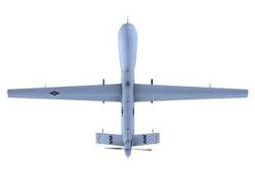
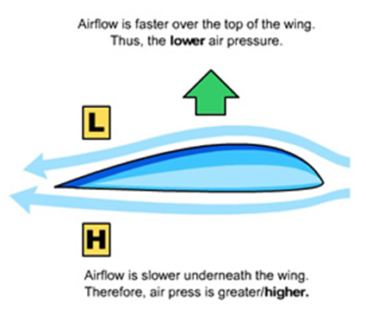
Main Parts Wings
Take the shape of ordinary airplane wings.
The geometry of wing causes a difference of pressure from top to bottom of the wing giving it “lift”.
The shape of the wing is called a tapered straight wing.
Design of the wing depends on:
Angle of attack
Density of air
Area of wing
Speed at which wing is traveling
Shape of the wing

Slide 5
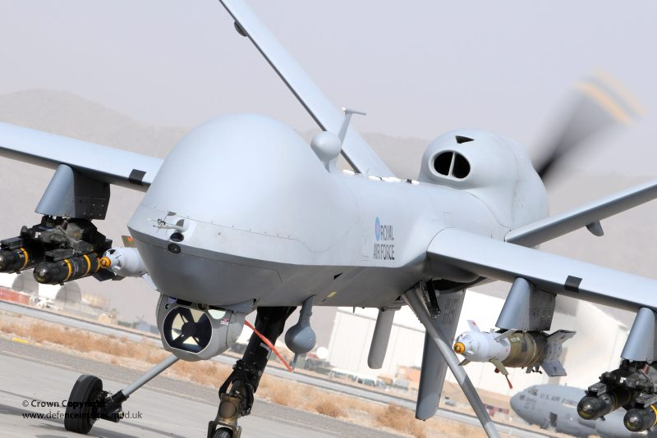
Fuselage
This is made of a mixture of carbon and quartz blended in a composite of Kevlar.
The fuselage houses various of components to make the MQ-1 Predator run.
The airframe of it is supported with Nomex, foam and wood laminate that are pressed together in layers.
The rib work of the structure is built from a carbon/glass fiber tape and aluminum.
The aerodynamic shape of the fuselage optimizes fuel usage by decreasing drag.

Slide 6
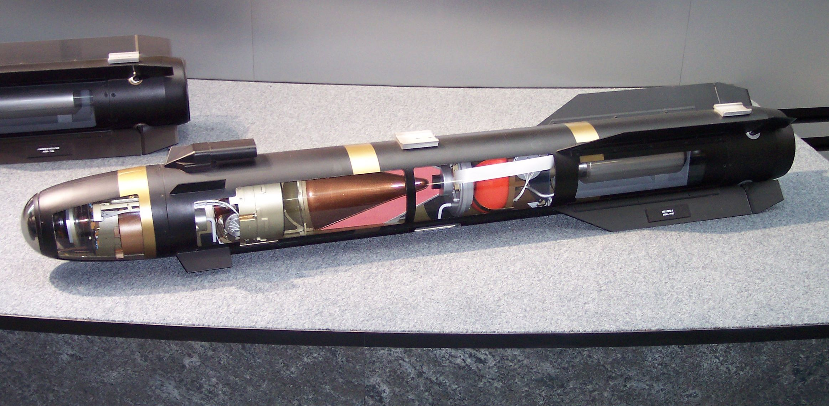
Hellfire Anti-tank Missiles
Air-to-surface missile
Costs about $110,000
This missile is supersonic so it strikes before its heard by the target.
It weighs from 100-108 lbs.
Inside it carries 20 lbs pf heat warheads and 18 lbs high temperature explosives.
The operational range goes from 546 yards-5miles.
This missile has a laser guidance system for pin point precision accuracy.

Slide 7
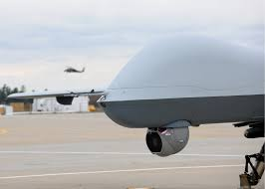
Surveillance Camera
The type of camera used in major UAV’s and in our model is a gimbal camera
Its known for having a fixed axis along the vertical and being able to rotate along the other two axis
Some common specs in these cameras are zooming, high quality imaging, and thermal graphic vision
Noted: One claim was it could read a license plate from 2 miles away

Slide 8
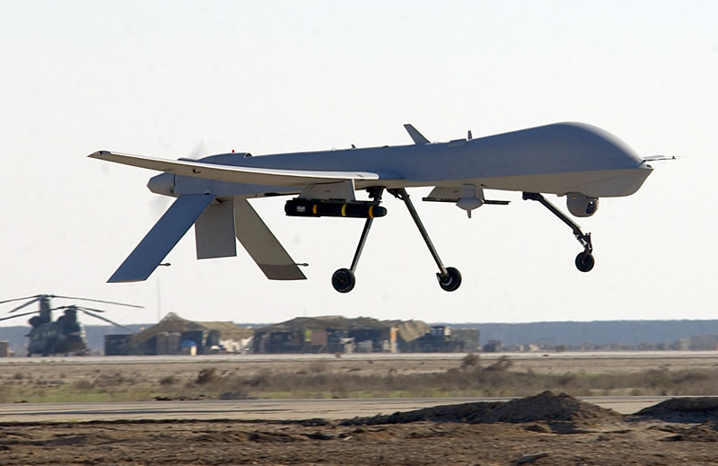
Landing Gear
The type of landing gear used in our MQ-1 Predator model is a tricycle landing gear
2 legs in the rear near the center of gravity and 1 nose leg under the head of the fuselage
In recent years the new landing gear for our model has increased the maximum weight capacity to approximately ~12,000 lbs.

Slide 9
Mechanism
The main mechanism of our model MQ-1 is the camera used for surveillance
The main part in our machine is the gimbal camera to collect intelligence on the ground
Modern drones carry weaponry due to adversary warfare. Making surveillance aircrafts into a weapon as well

Slide 10
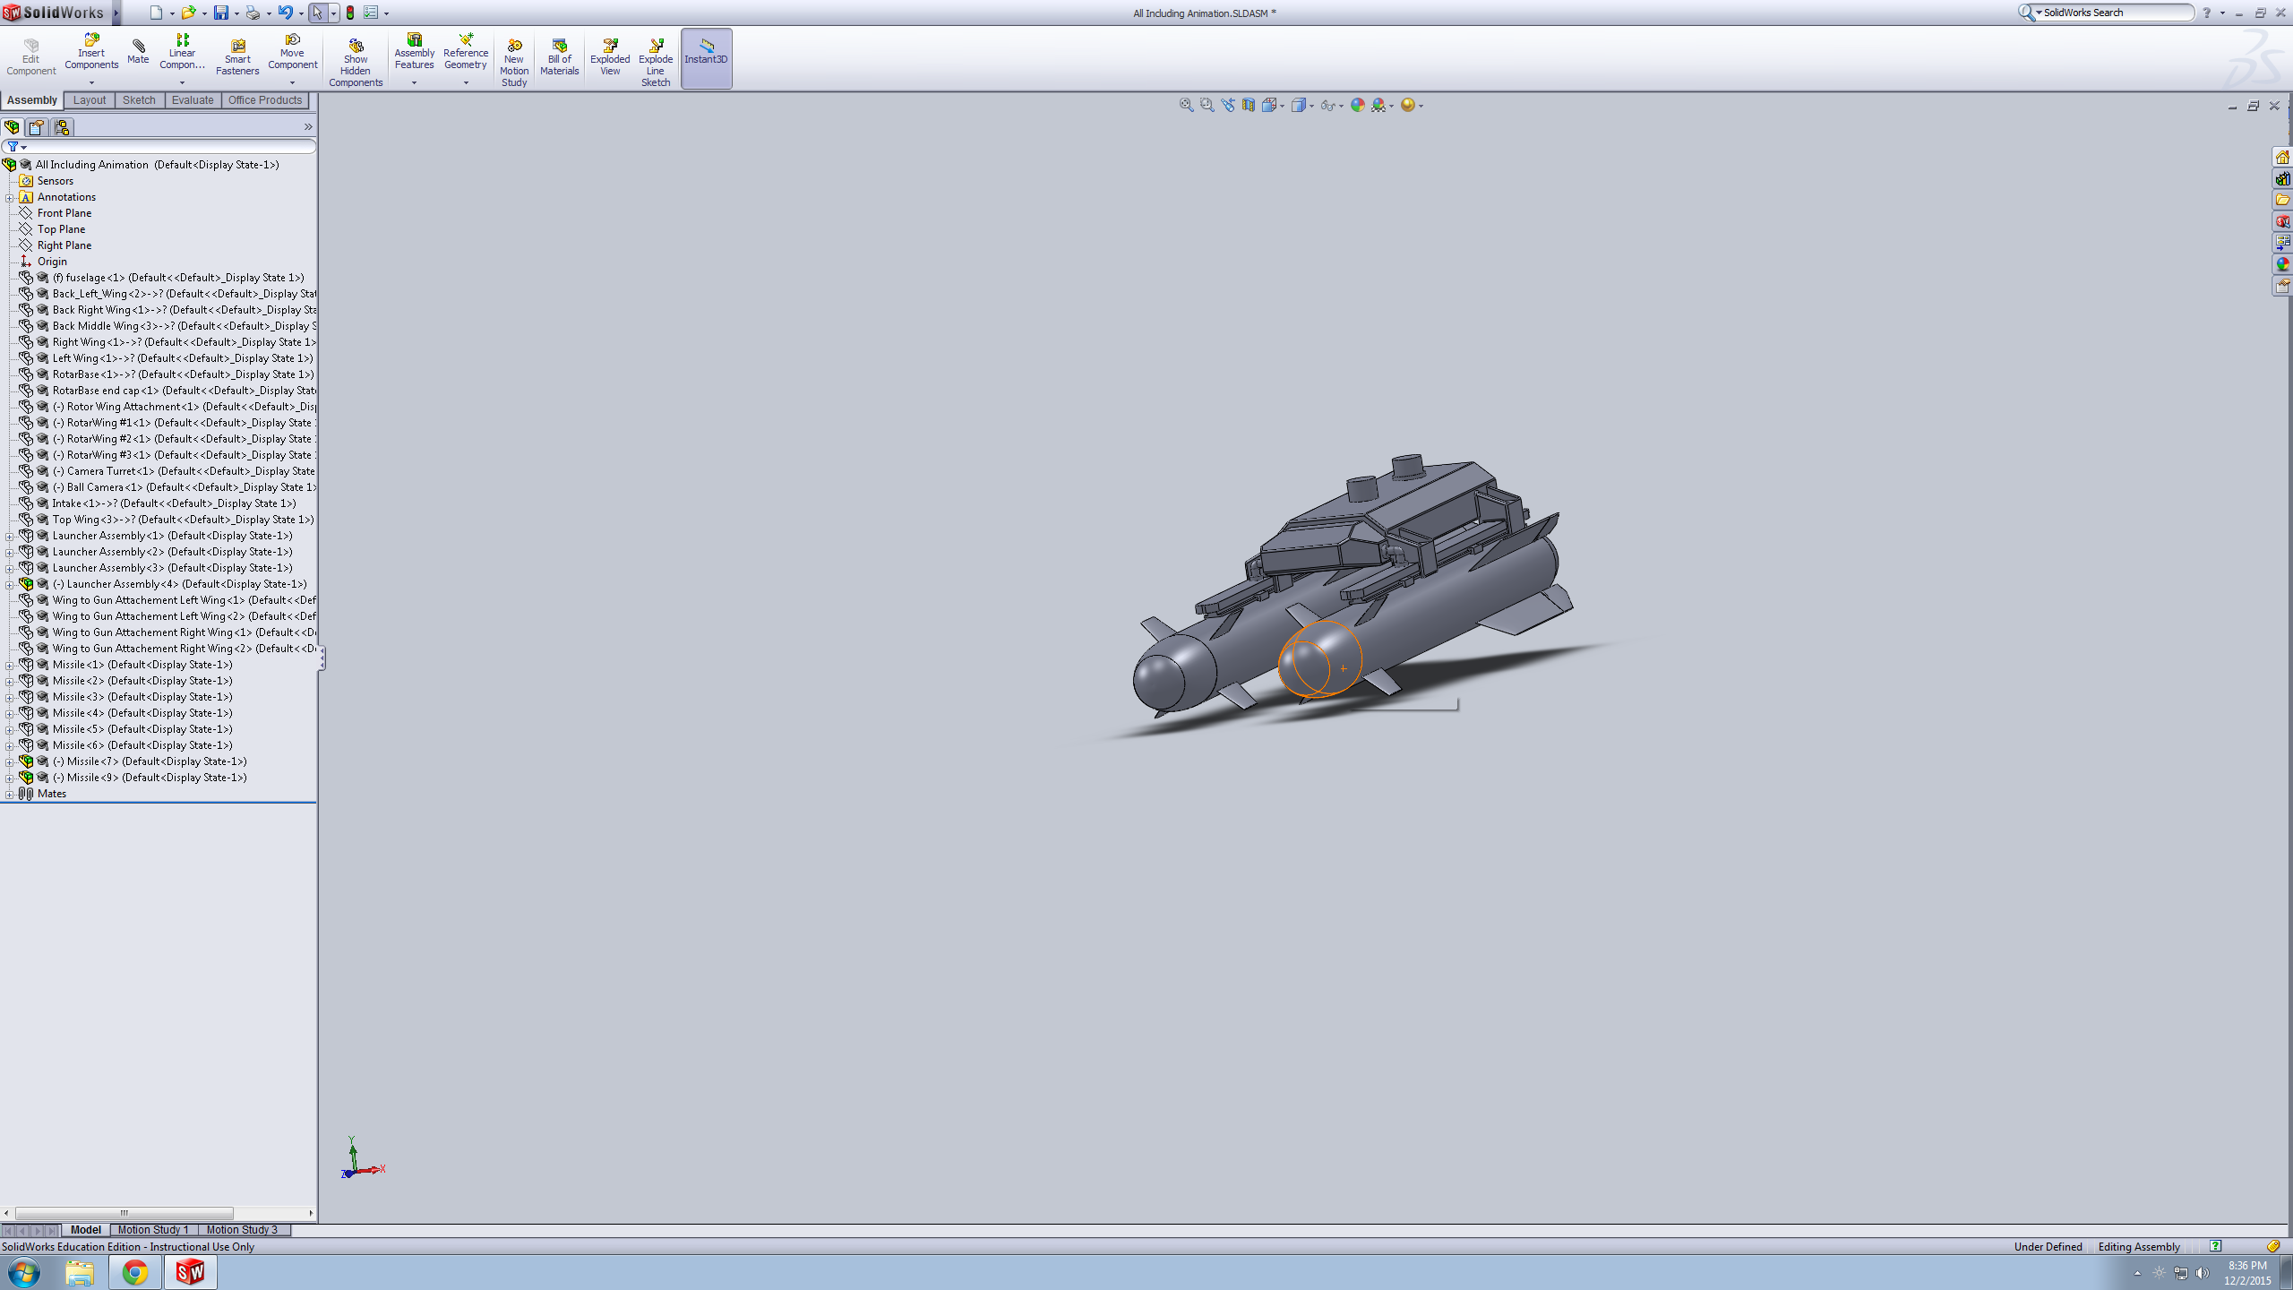
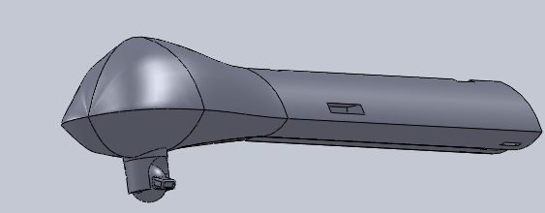
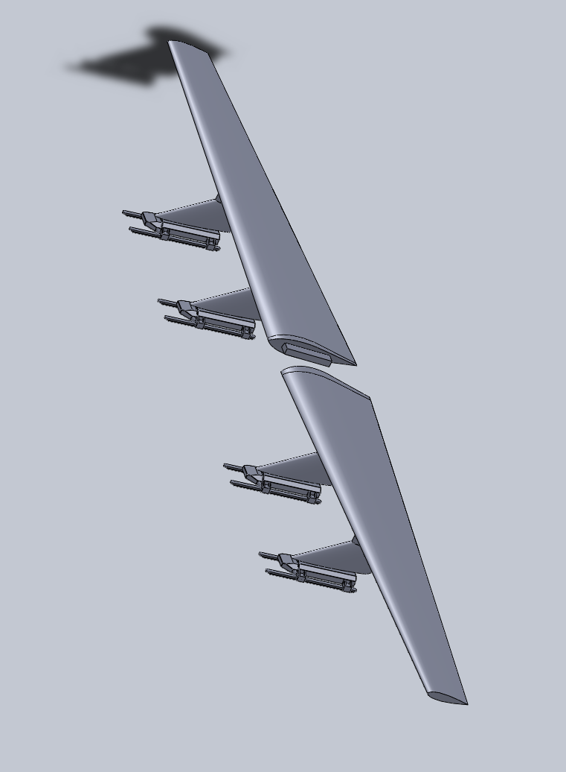
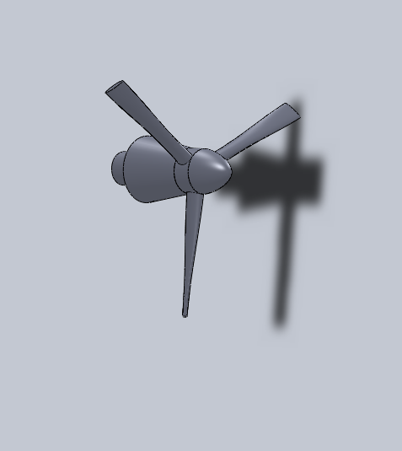
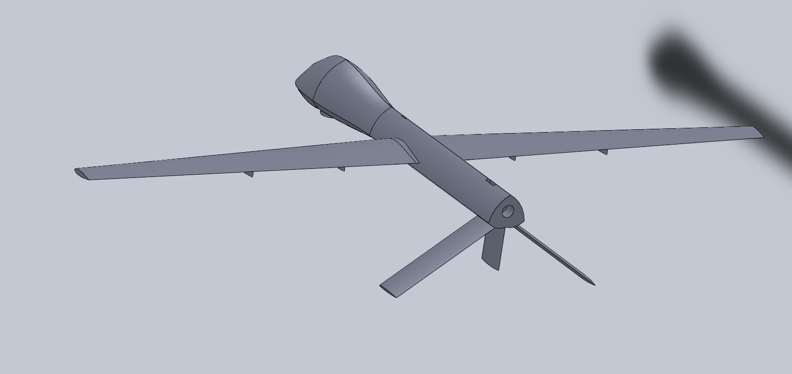
Main Mates

Slide 11
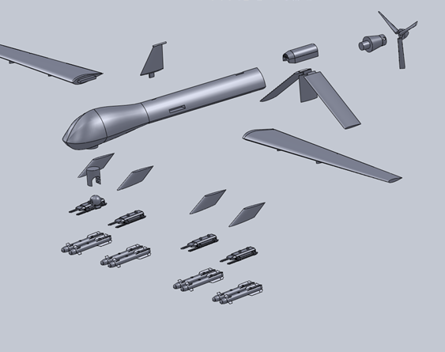
Explode View
This is an image showing all the main parts of our MQ-1 model
Fuselage
Wings
Rear Fan
Missiles
Camera

Slide 12
Animation
Our first animation is the fully assembled model moving
The rear fan rotation and the motion of the gimbal camera
Finally the release of a missile

Slide 13
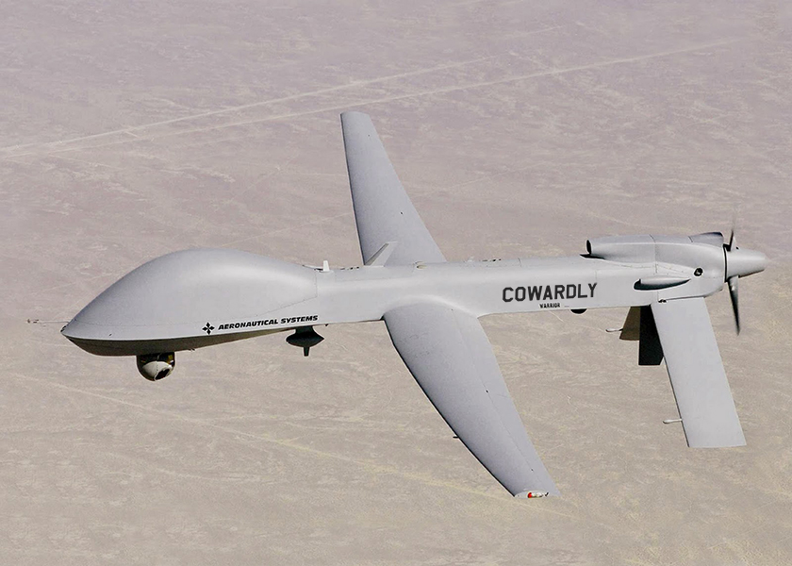
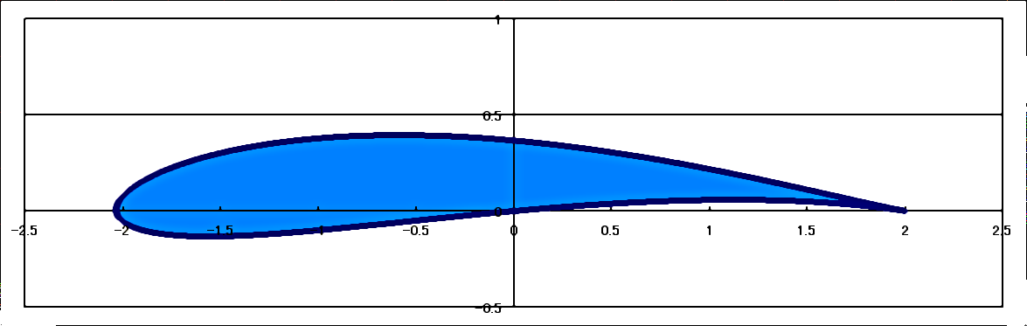
Techniques
Lofts and Splines
Aerodynamics require soft, smooth curves only available through spline features
Tapered edges require lofts and guide curves, not simple extrusions

Slide 14
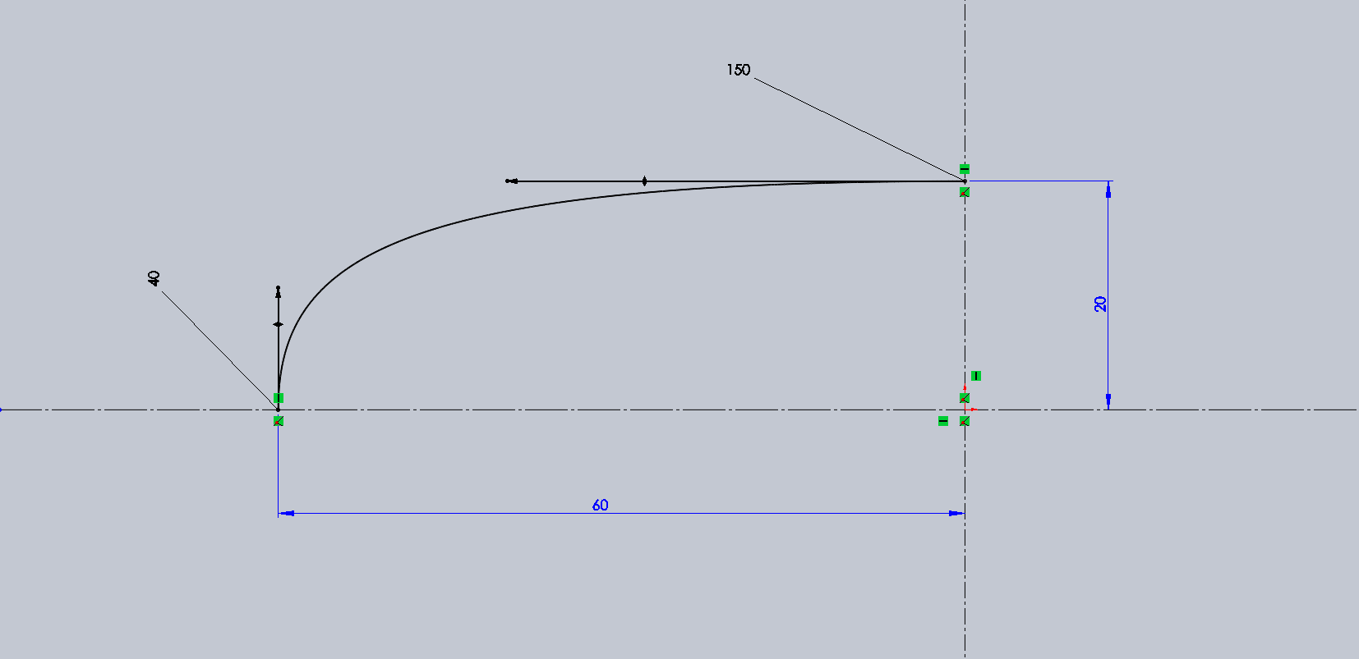
Why Splines
3 steps to fully define a spline
Length of end vectors
Angle of end vectors
Height & width
Point of inflection requires 3-point spline

Slide 15
Summary/Remarks
“Sparkle”
Fine detail in curvature
Mastery of the spline feature in 2-d and 3-d
If more time was allocated?
Building internal components of the Hellfire missile and fuselage
Rutgers Logos and details
3-D printing of the Model

Slide 16
References
http://theaviationist.com/tag/usaf/
https://en.wikipedia.org/wiki/AGM-114_Hellfire
http://www.defenseindustrydaily.com/uae-tie-up-inroduces-the-rq-1-predator-xp-06787/

